Slide 1
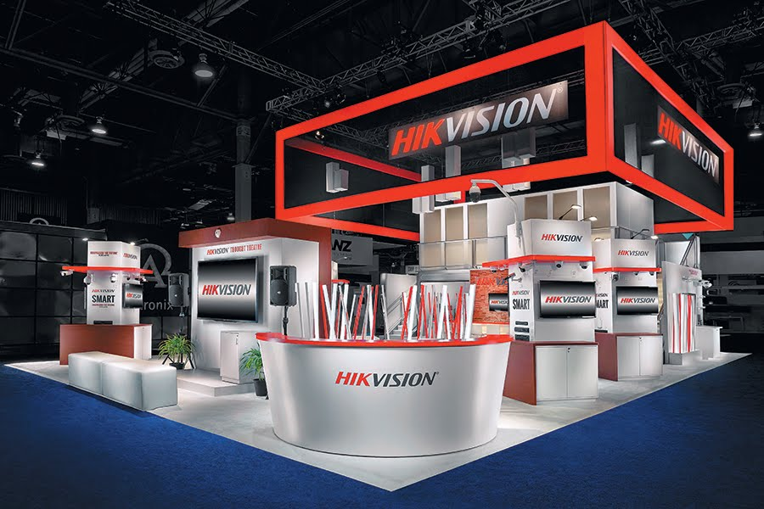

Performance Management Analysis
Supply Chain Department
MSBA 301
Jing Ding
Xiaoting Liu
Hanqing Huang
Notes:
Hello everyone. It is glad to introduce my group: xxx, xxx, xxx. Here we want to introduce a video surveillance company named Hikvision. We will focus on it supply chain department to do the performance management analysis.

Slide 2
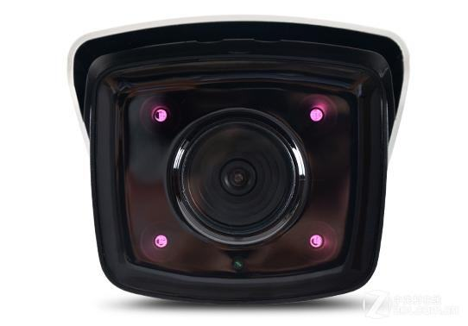
HIKVISION
ANALYSIS CONTENTS
Overview
Mock-up BSC
Five Force Analysis
Improvement Plan
Problems
& KPIs
Conclusions
Notes:
This is the contents of our presentation. We will introduce (从左上到右下念一遍）. First let’s see a short movie.

Slide 3
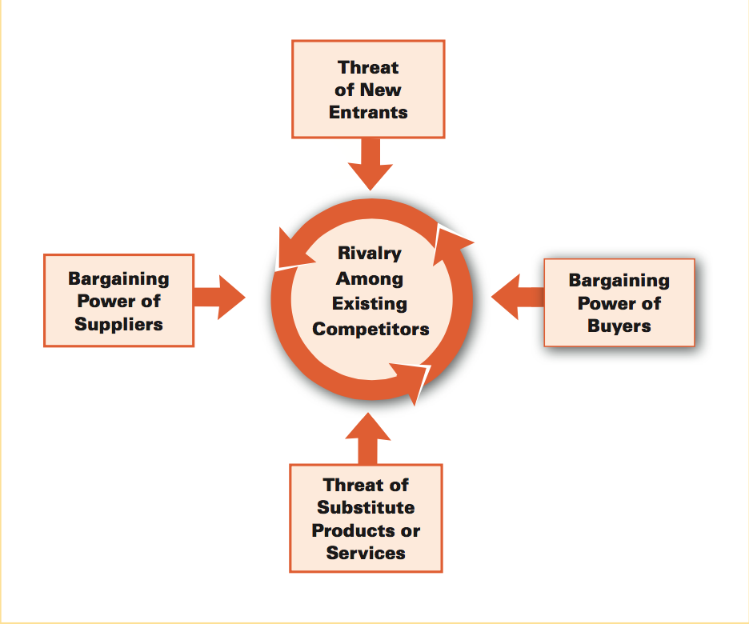
FIVE FORCE ANALYSIS
Low Threat of New Entrants
Technological barriers
Low Threat of Substitutes
Strong Competitiveness on R&D
Relatively Low Threat on Rivalry
Competitive Strategy Segmentation
Strong Bargaining Power of Buyers
Products with various functions
Strong Bargaining Power of Suppliers
Strong Competitiveness in Global Market
Notes:
Now we use five force model to analyze its competitiveness. From the video, we can see Hikvision has low threat of new entrants and substitutes due to the technical barriers and powerful R&D department. And strong bargaining power of buyers based on its various product lines. Strong bargaining power of buyers and suppliers based on its scale ecomony.

Slide 4
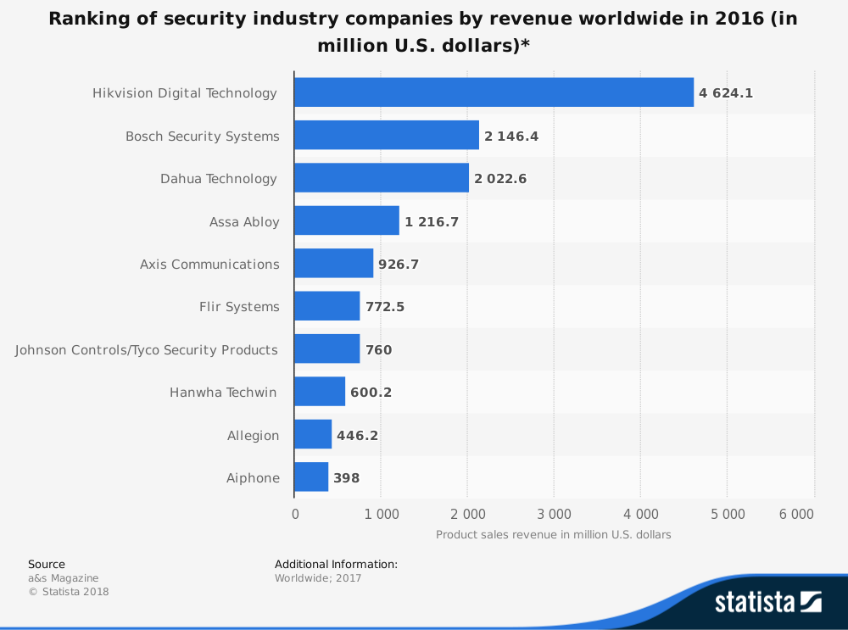
MARKET ANALYSIS
Global Market Share
Largest revenue share in the world
Twice than Bosch Security Systems
Notes:
This is the worldwide revenue ranking in 2016. We can see Hikvision gain the top revenue in the world at almost 5000 million and it is twice than the second one.

Slide 5
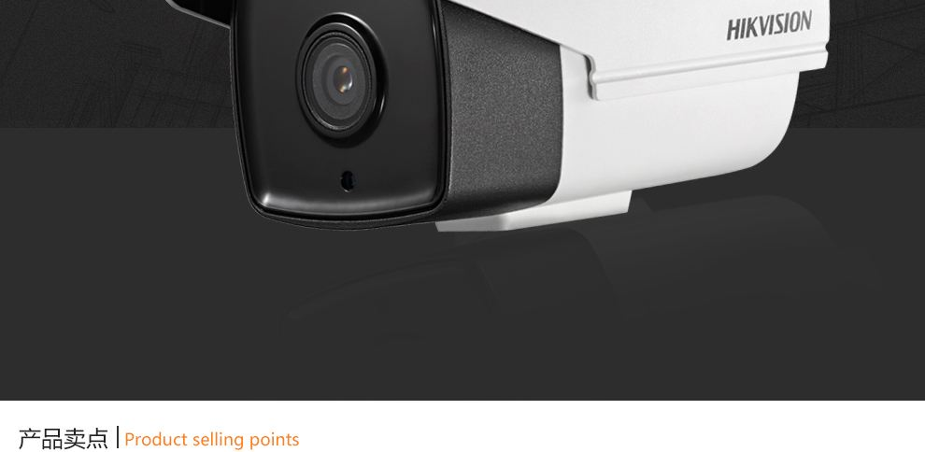
Main Problems
Supply Chain Department
Logistics
Inventory
Information
Notes:
We will separately discuss three main problems in Hikvision’s supply chain department

Slide 6

Logistics
Problem
HIKVISION USA
Oversea Transportation
Damages
(Variable Cost)
Standard
Cost
Control
(Fixed Cost)
Unpredictable
Delivery
Time
KPI
Order-Filling
Accuracy
KPI
Packaging Cost Control
(Recycle)
KPI
On-Time Delivery
Notes:
First one is logistics problem. We can see its delivery structure（翻到下一页 讲解也在下一页）So, we come up three metrics to improve the performance. In order to lower the cost, we deal with the variable costs and fixed costs separately.（第一个Jamie自己写的 我就不具体写了 注意这个是降低variable costs）The second one is to use recyle packaging materials. This is a creative method to reduce fixed costs and It is good to build up brand image, enterprise culture and social responsibility. Due to long distance transportation, there will be various unexpected accidents that may delay the shipping time, which is bad to customer satisfaction. So on-time delivery is the third metric we discuss in logisctics problem.

Slide 7


Logistics Structure Overview
End User
Online Store
End User
HIKVISION
HQ
HIKVISION
USA
Distributors
End User
End User
Dealers
End User
End User
Notes:
After the headquarter receives orders, Hikvision delivers the item from China to USA. Then the items will be shipped to distributors or end-users. We can see there is a long process on transportation.

Slide 8
KPI
Inventory Accuracy
Inventory
Problem
HIKVISION USA
Inventory Control
Order Policy
(Make-to-Order)
Inventory
Turnover
Ratio
Order
Completion
Rate
Return Policy
Notes:
The second problem is inventory. and we lists three aspects to improve the performance. (Theresa讲好了 我就不写了）
XL:可以的！

Slide 9
Information
Problem
HIKVISION USA
KPI
Negative
Review
Minimization
KPI
Response
Time
Promise
KPI
Loyalty
Employee
Retention
Problems
Customer Satisfaction
Long Response Time
Employee Satisfaction
KPI
Negative
Satisfaction
Improvement
KPI
Employee
Motivation
Enhancement
Notes:
我自己讲

Slide 10
HIKVISION
Mockup Balanced Scorecard
Financial
Internal & Process
Customer
Learning & Growth
Notes:
Now we will talk about mockup balanced scorecard on the following four aspects.

Slide 11
Financial
Capital Fund Liquidity Improvement
- Metrics: COGS/Average Inventory (%)
- Threshold: 10%
- Expectation: 85%
Fixed Cost Control on Recyclable Packaging
- Metrics: Actual Costs/Standard Cost (%)
- Threshold: 10%
- Expectation: 25%

Slide 12
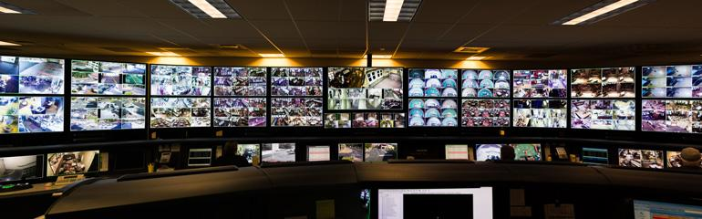
Customer
Negative Review Minimization (Monthly)
- Metrics: Negative Reviews/Total Reviews (%)
- Threshold: 10%
- Expectation: 5%
Service Quality Sustainability
- Metrics: Score Evaluation (0)
- Threshold: 5%
- Expectation: 9

Slide 13
Customer
On-time Delivery (Semi-Annually)
- Metrics: On-time Orders/Total Orders (%)
- Threshold: 15%
- Expectation: 98%
Order-filling Accuracy (Semi-Annually)
- Metrics: Error Orders/Total Order Amount (%)
- Threshold: 10%
- Expectation: 5% - 10%

Slide 14

Internal & Processes
Chain
Response Time Promise (Monthly)
- Metrics: # of Response Fails Per Month (0)
- Threshold: 5%
- Expectation: 8
Lead Time Improvement (Quarterly)
- Metrics: Completion Rate of Customers Orders (%)
- Threshold: 8%
- Expectation: 90%
Inventory Accuracy (Quarterly)
- Metrics: Inventory Level (%)
- Threshold: 8%
- Expectation: 95%
07

Slide 15
Learning & Growth
Employee Motivation Enhancement (Annually)
- Metrics: Rate of On-time Project Completion (%)
- Threshold: 15%
- Expectation: 98%
Employee Satisfaction Improvement (Annually)
- Metrics: Employee Satisfaction Evaluation (%)
- Threshold: 8%
- Expectation: 80%
Loyalty Employee Retention (Specific Period)
- Metrics: Three-year Employees/Total Employees (%)
- Threshold: 8%
- Expectation: 80%

Slide 16

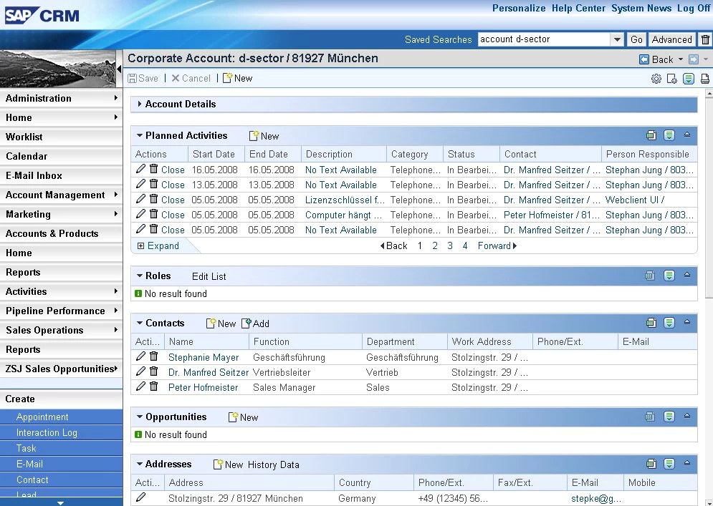
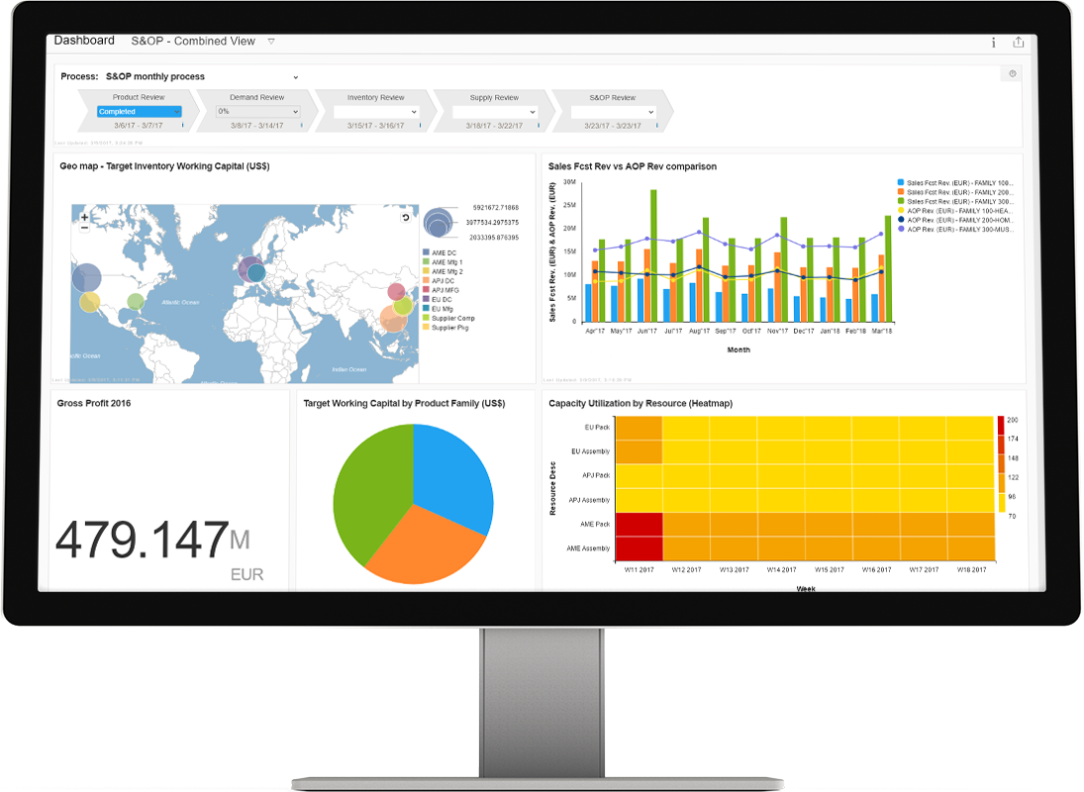
Automation Tools
Features
Inventory Recording
Logistic Information Evaluation
Customer Reviews Analysis
Two Proposed Automation Tools
SAP SCM (Supply Chain Management)
SAP CRM
(Customer Relationship Management)

Slide 17
Collection & Monitoring Plan
Automation Tools: collect the data - feed into our KPIs metrics.
Performing Analytical Review: detect unusual transactions
Alarm Notification: warn deviations from specification.
Analysis of Data
Gaining insights into department performance.
Improvement on efficiency and quality of decision-making.
Unnecessary cost reduction
Managers: sufficient information for performance evaluation
Employees: comprehensive understanding on performance

Slide 18
Performance Improvement Plan
Overview
Function: a dialogue between employee and supervisor
Goal: department performance improvement.
Discipline: SMART principle as the standards
Five Elements of the PIP:
Clearly stating the goal
Establishing a timeframe for meeting this goal
Developing an action plan
Establishing the periodic intervals for review of performance with the employee
Establishing consequences for failure to meet and sustaining improved performance

Slide 19
Conclusion
Set up Expectations
Comprehensively understand the implementation and purpose
Employees are requested to follow their responsibilities
Procedures and results should be recorded correctly into the performance plan
Observe Participants
Periodically monitor the performance to make sure everything is practical
Ask for Feedback/Give Feedback
Ask feedback from top to bottom to adjust the plan
Set up Retention System
Pay attention on loyal employees with outstanding performance

Slide 20
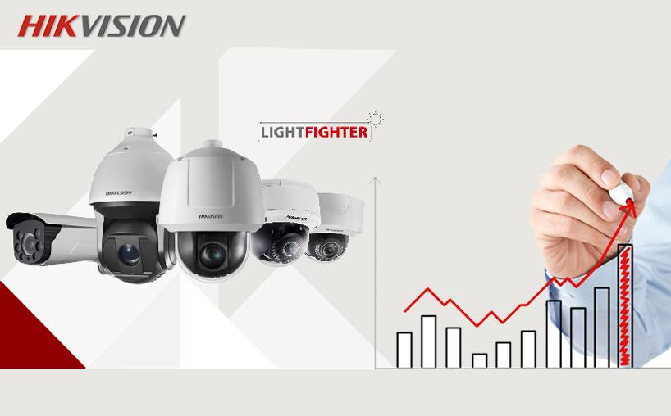

Our Competitiveness
Detailed Solution for Hikvision’ Supply Chain Department
Comprehensive analysis on Performance Management
Notes:
这里就是希望得到他们approval所阐述的我们这个plan的优势（如果你们觉得还有可以加！！）

Slide 21

Thank You
Thank you!

